Slide 1

DevBootcamp:
E-Learning Online Course
Website
Chirag Padyal_20104034
Vishal Bangar_20104084
Anuj Kundar_20104047
Project Guide
Ms. Rujata Chaudhari
Notes:
<number>

Slide 2
Contents
Introduction
Objectives
Scope
Literature Survey
Features
Project Outcomes
Technology Stack
Flowchart
Block Diagram
Notes:
<number>

Slide 3
1.Introdution
After this covid period E-Learning has become an important part of our education system, So we introduce DevBootCamp which is an online course provider for Aspiring Software developers.
DevBootCamp offers online courses, certifications, and degrees in various Tech Fields.
The Problem we identify is, Users need a website to track their work and create a routine that can maximize their workout.
The Solution we proposed is,The user will be able to track work for a particular day with the ability to add exercises. Each exercise can have a corresponding detail of sets and information about how to do the corresponding exercise

Slide 4
2. Objectives
To empower people to learn new and market trending tech fields using new tech courses.
To gamify the learning process.
To make best use of user’s time.
To add new skills in user’s arsenal.
Fast static files serving with Ngnix webserver
To track users learning progress.
To study any time you want and you an study with whomever you want.
To give you the flexibility to spend time with work ,family ,friends , significant other or any other activity you like.
Notes:
<number>

Slide 5
3. Scope
Can be used in Education field to empover at-place learning.
Can be used in Company’s and industries to tech workers their latest tech, with no human error.
Can be used by individual teacher, to spread its reach in global market.
Can be used to see improvement through quiz after completion of sections.
Notes:
<number>

Slide 6
4. Literature Survey
Title | Year | Technology Stack | Advantage | Limitation | URL
Online Teaching and Learning in Higher Education during the Coronavirus Pandemic | 2020 | nginx, mysql , nodejs, django, aws ec 2 , react, bootstrap, graphql | 1. Flexibility 2. Time Management Skill Development 3. Wider Range of Courses and Programs | Sample was non-probabilistic and the research was conducted only on two Romanian universities. Thus, the results can not be generalized to the entire Romanian higher education | link
Design of a Web-based Personalized E-learning Platform | 2018 | Apache , php , mysql , aws ec2 | It is implemented in B/S mode, which is one of the key points of the system. Interactive ability of the system Network service quality | The limitation of this system is e-learning create isolation. | link

Slide 7
5. Feature
User Review for each course
Course progress tracker
Wish-list course
Categories for courses
Certification generation after course completion
Secure payment portal
Easy course writing with mark-down.
Notes:
<number>

Slide 8
6. Outcome of Project
The final Outcome of the Project is as follows :
Certificate generation on course completion
Courses can be added with simple markdown editor
Courses can be Enrolled.
Course completion can be tracked.
Notes:
<number>

Slide 9
7. Technology Stack
Front-end:-
Framework :- React
State Manager:- Redux
Back-end:-
Framework:- Flask
Web-Server:- Ngnix
Auth:- Basic Auth
Security:- Json Web Token
Database :- PostgreSQL.
Notes:
<number>

Slide 10
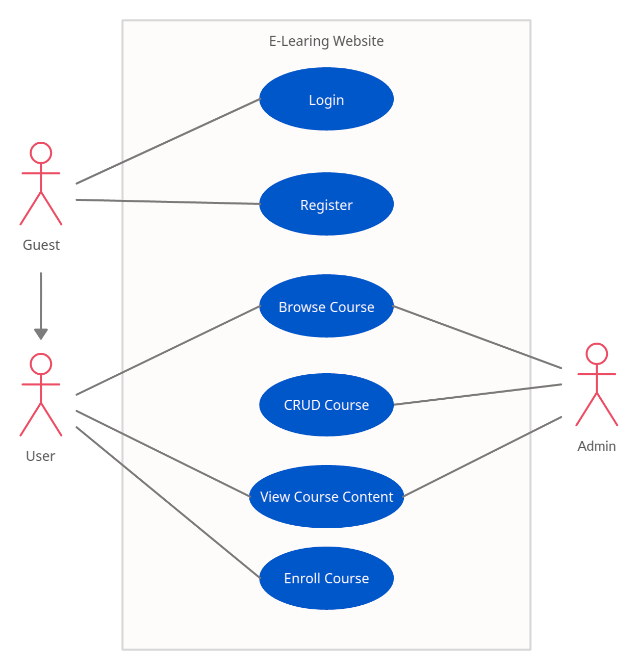
8. Use Case Diagram

Slide 11
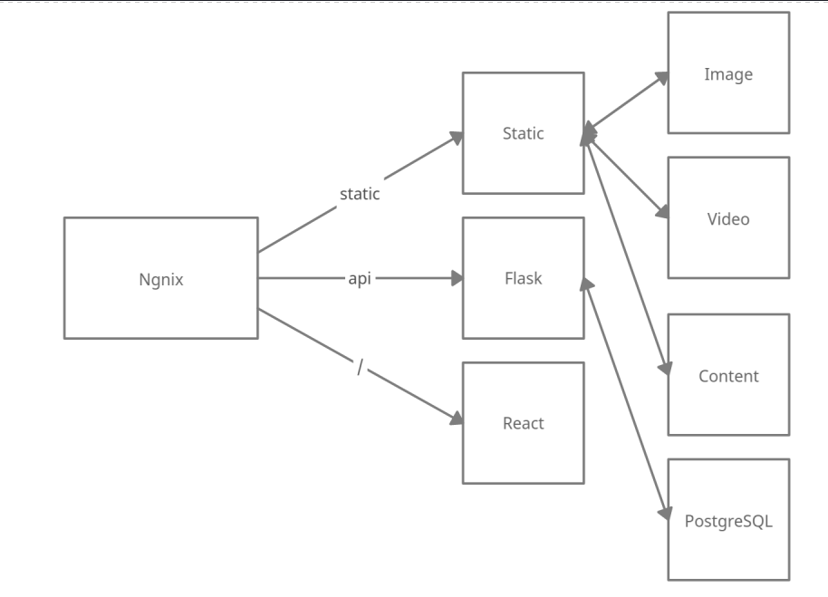
9. Block Diagram

Slide 12
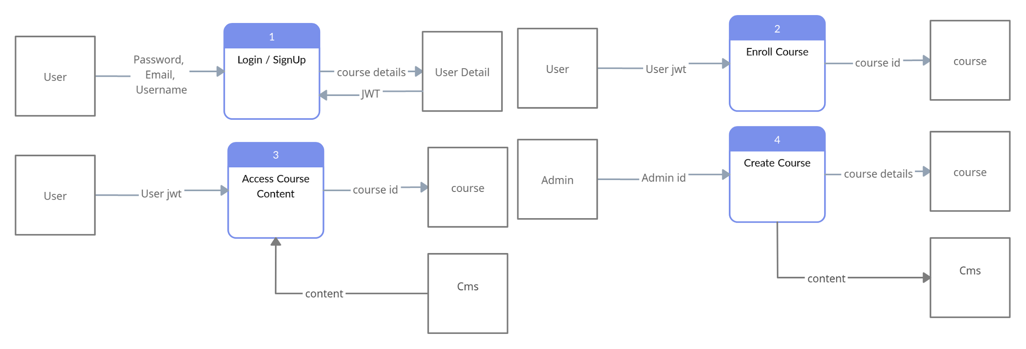
10. DFD

Slide 13
11. Suggestion in Review 1
Add video in course content
Add Quiz after each course module
Add Email Authentication
Tabular Literature Review
Course Categories

Slide 14
12. References
Courses as markdown:- https://github.com/remarkjs/react-markdown/
Fetch Static (i.e. videos, markdownfiles, images):-https://fedingo.com/how-to-use-nginx-with-flask/
JWT :- https://www.geeksforgeeks.org/using-jwt-for-user-authentication-in-flask/
Dockerize:- https://blog.miguelgrinberg.com/post/how-to-dockerize-a-react-flask-project

Slide 15
Thank You...!!
Notes:
<number>

